Slide 1
CSE 140L Lab 3
Traffic Light Controller

Slide 2
Lab 3 Summary
1. Understand Harris & Harris traffic light example
start with 4 states; one side = green or yellow while other = red
2. Understand extension to 6 states to include all-red/clear states
Why 2 all-red? Keeps track of who most recently had a green.
3. Augment with:
protected left turn lanes on one street (makes it a 3-way decision)
timeouts for green light phases
4. What your controller has to decide:
based on current traffic & past light phases, who gets the green now?
how soon does this green change to yellow?

Slide 3
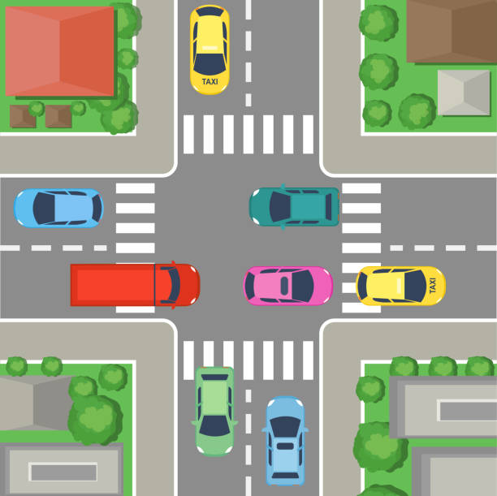
Harris & Harris Textbook Example
4-way intersection
N&S get same light color
E&W get same light color
4 states:
NS green + EW red
NS yellow + EW red
NS red + EW green
NS red + EW yellow

Slide 4
light states
Each light has three colors: Green, Yellow, and Red.
After a green light, the light will always turn yellow for 2 clock cycles before turning red, and the all-red (clear intersection).
The colors are encoded as follows: Green = 2, Yellow = 1, and Red = 0
(Note: Harris & Harris use Green, Yellow, Red = 0, 1, 2, instead)

Slide 5
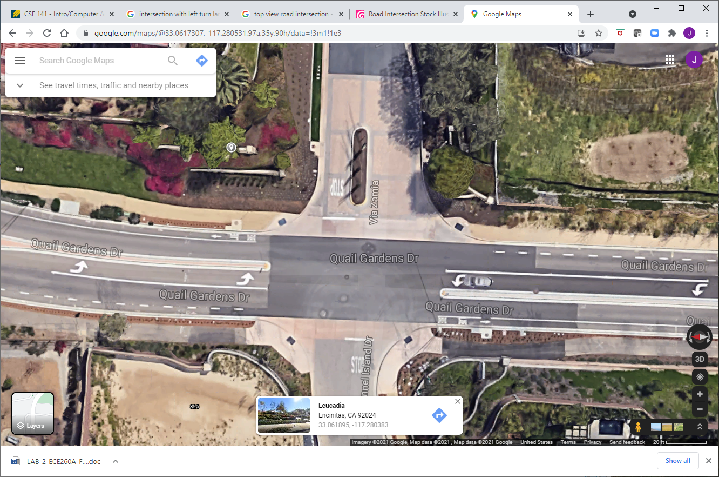
How Our Assignment Builds on H&H
In our lab assignment, each direction on the EW street has a straight lane and a separate left turn lane.
Each left turn lane is protected, i.e., it has a dedicated left arrow turn signal.

Slide 6
EW vs NS Operation
Both directions on the NS street contain only straight/left option lanes.
If a car wants to make a left turn, it must make an unprotected left turn, in which the opposing straight/left green is also lit.
Thus, there are sets of two traffic signals (left turn arrow and straight green light) facing each direction on the main (EW) street, but only one set of lights facing each direction of the minor (NS) street.

Slide 7
Symmetry for Simplicity
The lights for the east and west directions are symmetric, meaning that the west direction will never have both its turn signal and straight signal green at the same time, with the east direction all red. Either both east and west straight lanes are green, or both east and west left turn lanes are green and the straight lanes are red, to prevent a left-cross collision.
The north and south direction lights are identical to each other.

Slide 8
Part 1 has 7 allowable states for the lights
EW straight = EWS = S | EW left arrow = EWL = L | NS (straight or unprotected left) = N
Red | Red | Red
Green | Red | Red
Yellow | Red | Red
Red | Green | Red
Red | Yellow | Red
Red | Red | Green
Red | Red | Yellow

Slide 9
About that red state
If we got to all-red from NS yellow, then EW_straight has top priority for green, followed by EW_left, and then NS again.
If we got to all-red from EW_straight yellow, then EW_left has top priority, followed by NS, then EW_straight again.
If we got to all-red from EW_left yellow, then NS has top priority, followed by EW_straight, and then EW_left again.
Maybe 3 separate all-red states in the controller?
Recall 5-state vs. 6-state versions of H&H controller

Slide 10
traffic detection, Part 1
All lanes have traffic sensors that can trigger a change in the lights.
The EW lanes have separate traffic sensors for cars going straight and cars in either of the left turn lanes.
Cars going straight from either E or W trigger the EW straight sensor.
The NS lanes have sensors which do not distinguish between going straight or turning left (there are no dedicated protected left turn lanes).

Slide 11
Starting State
The starting state of the intersection is all red lights (all-red phase) for EWS, EWL, and NS signals, with EWS having top priority for a green light. This is the same red state we reached after a NS_yellow.
Absent traffic, the system will always eventually return to one of the all-red states.

Slide 12
Green timeout
If the signals are all-red and traffic is detected on one and only one sensor, the corresponding light turns green and stays green until 5 clock cycles after traffic is not detected, even for one clock cycle, at which point it turns yellow for 2 clock cycles and then red.
As long as traffic is detected continuously and on this sensor only, it will remain green.
Once the countdown timer starts, it will continue to timeout/yellow, even if traffic reappears during the countdown. Thus, any gap in same-direction traffic will launch the countdown.

Slide 13
Conflicting traffic demand
However, it will turn yellow 10 clock cycles after traffic is detected on one or both of the other/conflicting sensors. Once the 10-count starts, it continue to yellow, even if the conflicting traffic disappears (they turn around or back up or run the red light :) ).
Further clarification: think of 5 clock cycles as a minimum green duration (car detected for only one clock pulse) and 10 clock cycles as a maximum after cross traffic is detected, even if same-direction traffic remains present, to give cross traffic a fair chance.
(Maximum green time is unlimited if traffic remains present in a given direction, with none in the other directions.)

Slide 14
Counts keep going once started
Once there is a break in green-direction traffic, the 5-cycle countdown begins, even if traffic reappears during the countdown.
Likewise, the 10-cycle countdown begins as soon as conflicting traffic appears.
If same-direction traffic goes away during the 10-cycle countdown, the 5-cycle countdown commences and may trigger an earlier transition to yellow.

Slide 15
Initial priority from all-red
From the initial/reset/starting all-red phase, if traffic appears simultaneously at multiple sensors, the precedence is as follows:
EWS > EWL > NS
For example, if there is a car on the EWS sensor, the EWS signal will become green, regardless of the other lanes. If there is traffic on both the EWL and the NS simultaneously and none on EWS, the EWL will become green first.

Slide 16
fairness doctrine
“Fairness doctrine”:The green light precedence rotates according to which direction most recent had a green-yellow sequence.
Thus, if EWS just had a turn, then the precedence becomes: EWL > NS > EWS.
We can get two EWS green-yellow-red cycles in a row, but only absent traffic in the other two directions.
If the EWL most recently had a green-yellow cycle, then NS has top priority, and EWL has lowest priority.
Following an NS green-yellow, EWS again has top priority, followed by EWL and then NS.

Slide 17
rush hour!
If all sensors always have traffic, then the precedence is the same. That is, the intersection will cycle between EWS green for 10 clocks, then yellow for 2 clocks, then all red for 1, then EWL green for 10 clocks, then yellow for 2, then all red for 1, then NS green for 10 and yellow for 2 and all red for 1, before EWS becomes green again.
You have two decisions to make: How long a given light stays green before turning yellow, and which green light follows a given all-red phase.

Slide 18
Part 2
For part 2, we separate out two additional modes, so we now have:
East Straight + West Straight = "S," as before
East Straight + East Left = "E," new state
West Straight + West Left = "W," new state
East Left + West Left = "L," as before
North + South = "N," as before
These are listed in order of priority, so we start w/ S, then give E top priority on timeout, etc.

